Slide 1

A Deep Artificial Neural Network Model for Classification of Chronic Kidney Disease with Machine Learning Algorithms
Present by
Md. Ashik Miah
[0122310005]

Slide 2
Problems
Problems:
Globally, chronic kidney disease directly resulted in an estimated 1.23 million deaths in 2017 with an additional 1.36 million deaths attributable to cardiovascular disease resulting from impaired kidney function (HealthData).
The vital statistics survey of Bangladesh Bureau of Statistics (BBS) found that 28,017 people had died from kidney disease in 2020, up from 10,622 a year before (BBS).
According to the latest WHO data published in 2020 Kidney Disease Deaths in Bangladesh reached 10,841 or 1.51% of total deaths (worldlifeexpectancy).
The outcomes of the included studies (nine studies, a total of 225,206 participants) based on meta-analysis showed an overall prevalence of CKD in Bangladeshi people of 22.48%, which was higher than the global prevalence of CKD [17].
Just over 3 million people in the UK are thought to be at risk for CKD. There were 697.5 million cases of chronic kidney disease in 2017 (HealthData).
Nearly one-third of those patients lived in two countries – China, with about 132 million cases, and India, with about 115 million. Further, 10 other nations the US, Indonesia, Russia, Japan, Brazil, Pakistan, Mexico, Nigeria, Bangladesh, and Vietnam each had more than 10 million cases in 2017 (HealthData).

Slide 3
Literature Review
Existing Work: Prediction Kidney Disease
[6] "Predictive analytics for chronic kidney disease using machine learning techniques " (MITIC-2016):
The study emphasized the importance of feature selection in improving model performance.
This research focused on predicting the progression of kidney disease using machine learning.
It examined various predictive models, including logistic regression, K-nearest neighbors (KNN), support vector machine (SVM).
[1] "Chronic Kidney Disease Prediction on Imbalanced Data by Multilayer Perceptron " (IEEE ACSAC-2017):
This study proposed techniques to improve the prediction of chronic kidney disease, with a specific focus on addressing class imbalance.
It explored the use of synthetic data generation and ensemble learning methods.
[12] " MedAi: A Smartwatch-Based Application Framework for the Prediction of Common Diseases Using Machine Learning " (IEEEXplore-2023):
This research successfully created a framework for the "MedAi" system, which involved creating a machine learning model and designing a smartwatch with numerous sensors and suggesting a structure for an Android health app that forecasts twelve different types of disease.
The RF algorithm was used to build the model, and it produced an accuracy of 99.4% compared to other well-liked techniques like KNN (99.3%) and XGB (98.56%)

Slide 4
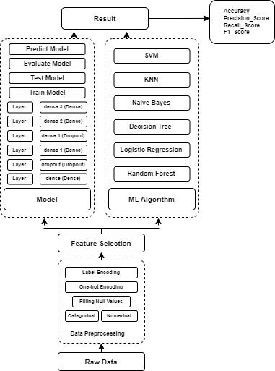
Methodology
Raw data collection.
Preprocessing data.
Feature.
Classification algorithms.
Own Model
Data Train.
Data Test.
Prediction
Classification Report.
Accuracy.
Proposed Chronic Kidney Prediction System

Slide 5
Propose Model Architecture
Model: "sequential"
Layer (type) | Output Shape
dense (Dense) | (None, 32)
dropout (Dropout) | (None, 32)
dense_1 (Dense) | None, 64)
dropout_1 (Dropout) | (None, 64)
dense_2 (Dense) | (None, 128)
dense_3 (Dense) | (None, 1)
Total params: 11361 (44.38 KB) Trainable params: 11361 (44.38 KB) Non-trainable params: 0 (0.00 Byte)

Slide 6
SL | Input Attributes | Type
1 | Age | numerical
2 | Blood pressure | numerical
3 | Specific Gravity | nominal
4 | Albumin | nominal
5 | Sugar | nominal
6 | Red blood cells | nominal
7 | Pus Cell | nominal
8 | Pus Cell clumps | nominal
9 | Bacteria | nominal
10 | Blood Glucose Random | numerical
11 | Blood Urea | numerical
12 | Serum Creatinine | numerical
13 | Sodium | numerical
14 | Potassium | numerical
15 | Hemoglobin | numerical
16 | Packed Cell Volume | numerical
17 | White Blood Cell Count | numerical
18 | Red Blood Cell Count | numerical
19 | Hypertension | nominal
20 | Diabetes Mellitus | nominal
21 | Coronary Artery Disease | nominal
22 | Appetite | nominal
23 | Pedal Edema | nominal
24 | Anemia | nominal
25 | Class | nominal
Data Set Attributes
Number of Instances: 400 (250 CKD, 150 notckd)
Number of Attributes: 24 + class = 25
( 11 numeric, 14 nominal)
Missing Attribute Values: Denoted by "?“
Class Distribution: ( 2 classes)
Class Number of instances
ckd 250
notckd 150

Slide 7
ML Algorithms
Type of machine learning algorithms.
Supervised Learning.
SVM.
Naive Bayes.
Decision Tree.
KNN.
Logistic Regression.
Random Forest.
Unsupervised Learning.
Here will discuss about Supervised machine learning algorithms.

Slide 8
Discussion
Manual Approach
Accuracy Measurements
Classification Models |  | Proposed Model
ML Algorithms | Accuracy | Accuracy
Random Forest | 100% | 98.75%
Logistic Regression | 98.75%
Decision Tree | 98.75%
Naive Bayes | 98.75%
KNN | 97.50%
SVM | 65%
Input Data
Classification Models
Support Vector Machines
CKD Prediction System
K-Nearest Neighbors
Naive Bayes
Decision Tree
Accuracy
Age
Bp
Sg
Al
Su
Rbc
Bgr
Bu
Sc
Pc
Pcc
Ba
Logistic Regression
Random Forest.
Propose Model.
F1-score
Recall
Precision
Sod
Pot
Hemo
Pcv
Wbcc
Rbcc
Htn
Dm
Cad
Appet
Pe
Ane
Class

Slide 9
Classification Report
ML Algorithms\Model | Precision | Recall | F1-Score
Random Forest | 1.0 | 1.0 | 1.0
Logistic Regression | 0.97 | 1.0 | 0.98
Decision Tree | 0.97 | 1.0 | 0.98
Naive Bayes | 0.97 | 1.0 | 0.98
KNN | 0.93 | 1.0 | 0.97
SVM | - | - | -
Propose Model | 0.96 | 1.0 | 0.98

Slide 10
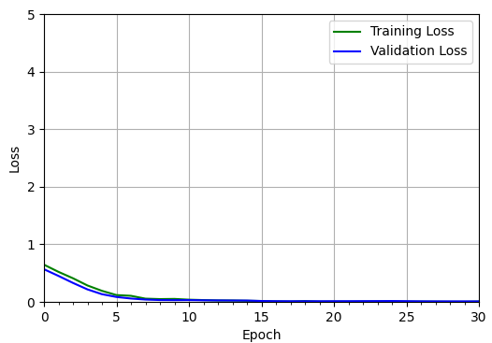
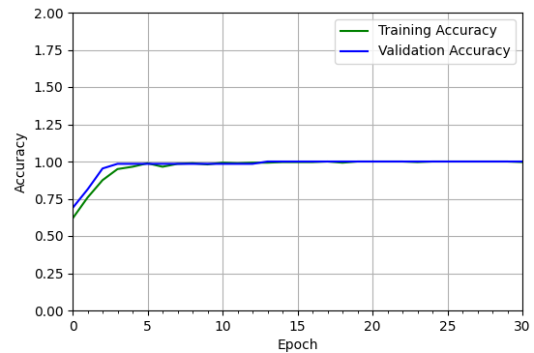
Training and Validation Loss, Accuracy
Training and validation loss
Training and validation accuracy

Slide 11
Performance Analysis
Statistics Correlation Matrix
 | age | bp | sg | al | su | rbc | pc | pcc | ba | bgr | bu | sc | sod | pot | hemo | pcv | wbcc | rbcc | htn | dm | cad | appet | pe | ane
age | 1 | 0.148004 | -0.18057 | 0.114764 | 0.231691 | -0.01178 | -0.10195 | 0.159074 | 0.043573 | 0.21441 | 0.275522 | 0.240908 | -0.05217 | 0.074722 | -0.17538 | -0.2118 | 0.100061 | -0.20105 | 0.39344 | 0.363475 | 0.232951 | 0.157741 | 0.094434 | 0.050567
bp | 0.148004 | 1 | -0.18246 | 0.146593 | 0.212998 | -0.15137 | -0.15686 | 0.05956 | 0.112173 | 0.1491 | 0.167769 | 0.250758 | -0.0747 | 0.084119 | -0.27954 | -0.29271 | 0.026067 | -0.22082 | 0.270447 | 0.22825 | 0.086618 | 0.177601 | 0.054083 | 0.194962
sg | -0.18057 | -0.18246 | 1 | -0.4667 | -0.3075 | 0.236228 | 0.345325 | -0.29066 | -0.22079 | -0.32634 | -0.30039 | -0.41128 | 0.104101 | -0.01922 | 0.531755 | 0.528437 | -0.20131 | 0.466976 | -0.36696 | -0.39319 | -0.1548 | -0.24682 | -0.27248 | -0.21328
al | 0.114764 | 0.146593 | -0.4667 | 1 | 0.305555 | -0.37393 | -0.53516 | 0.399749 | 0.367855 | 0.3264 | 0.429562 | 0.462698 | -0.11079 | 0.112747 | -0.5497 | -0.52724 | 0.200443 | -0.45489 | 0.481724 | 0.378042 | 0.236745 | 0.330562 | 0.440893 | 0.282305
su | 0.231691 | 0.212998 | -0.3075 | 0.305555 | 1 | -0.08311 | -0.1839 | 0.171502 | 0.127363 | 0.643699 | 0.188902 | 0.244857 | -0.03146 | 0.163653 | -0.22297 | -0.22898 | 0.173182 | -0.20884 | 0.316193 | 0.495283 | 0.284503 | 0.115781 | 0.147334 | 0.090566
rbc | -0.01178 | -0.15137 | 0.236228 | -0.37393 | -0.08311 | 1 | 0.377394 | -0.10295 | -0.1844 | -0.15308 | -0.20012 | -0.25561 | 0.04577 | 0.011441 | 0.28099 | 0.280958 | -0.00221 | 0.202455 | -0.14054 | -0.14565 | -0.11149 | -0.16087 | -0.19928 | -0.10763
pc | -0.10195 | -0.15686 | 0.345325 | -0.53516 | -0.1839 | 0.377394 | 1 | -0.52012 | -0.3304 | -0.26226 | -0.33154 | -0.31705 | 0.056359 | -0.14046 | 0.4115 | 0.41858 | -0.10789 | 0.38324 | -0.29172 | -0.20103 | -0.17229 | -0.27498 | -0.35023 | -0.26057
pcc | 0.159074 | 0.05956 | -0.29066 | 0.399749 | 0.171502 | -0.10295 | -0.52012 | 1 | 0.275082 | 0.197593 | 0.217795 | 0.182853 | -0.0493 | 0.006819 | -0.27576 | -0.29424 | 0.163456 | -0.26798 | 0.195623 | 0.165236 | 0.188029 | 0.189688 | 0.104356 | 0.175861
ba | 0.043573 | 0.112173 | -0.22079 | 0.367855 | 0.127363 | -0.1844 | -0.3304 | 0.275082 | 1 | 0.08594 | 0.179307 | 0.162716 | -0.02392 | 0.025585 | -0.20495 | -0.18982 | 0.103546 | -0.19222 | 0.089046 | 0.08007 | 0.162395 | 0.149126 | 0.134732 | 0.052208
bgr | 0.21441 | 0.1491 | -0.32634 | 0.3264 | 0.643699 | -0.15308 | -0.26226 | 0.197593 | 0.08594 | 1 | 0.177916 | 0.196472 | -0.06387 | 0.038709 | -0.26915 | -0.26758 | 0.121371 | -0.22257 | 0.369849 | 0.500618 | 0.212433 | 0.176132 | 0.101502 | 0.126854
bu | 0.275522 | 0.167769 | -0.30039 | 0.429562 | 0.188902 | -0.20012 | -0.33154 | 0.217795 | 0.179307 | 0.177916 | 1 | 0.724497 | -0.19702 | 0.268104 | -0.55963 | -0.53733 | 0.069419 | -0.4678 | 0.470188 | 0.37412 | 0.24819 | 0.290611 | 0.311231 | 0.411377
sc | 0.240908 | 0.250758 | -0.41128 | 0.462698 | 0.244857 | -0.25561 | -0.31705 | 0.182853 | 0.162716 | 0.196472 | 0.724497 | 1 | -0.36041 | 0.228758 | -0.62477 | -0.60532 | 0.075942 | -0.52896 | 0.50288 | 0.397463 | 0.258501 | 0.318686 | 0.320394 | 0.427981
sod | -0.05217 | -0.0747 | 0.104101 | -0.11079 | -0.03146 | 0.04577 | 0.056359 | -0.0493 | -0.02392 | -0.06387 | -0.19702 | -0.36041 | 1 | 0.02975 | 0.156064 | 0.169167 | 0.031895 | 0.173038 | -0.16686 | -0.15431 | -0.19591 | -0.04882 | -0.04459 | -0.06778
pot | 0.074722 | 0.084119 | -0.01922 | 0.112747 | 0.163653 | 0.011441 | -0.14046 | 0.006819 | 0.025585 | 0.038709 | 0.268104 | 0.228758 | 0.02975 | 1 | -0.12545 | -0.16645 | -0.0991 | -0.14645 | 0.085842 | 0.092952 | 0.054073 | 0.004132 | 0.075173 | 0.109432
hemo | -0.17538 | -0.27954 | 0.531755 | -0.5497 | -0.22297 | 0.28099 | 0.4115 | -0.27576 | -0.20495 | -0.26915 | -0.55963 | -0.62477 | 0.156064 | -0.12545 | 1 | 0.854962 | -0.15382 | 0.682257 | -0.58077 | -0.46806 | -0.28046 | -0.39114 | -0.38277 | -0.55581
pcv | -0.2118 | -0.29271 | 0.528437 | -0.52724 | -0.22898 | 0.280958 | 0.41858 | -0.29424 | -0.18982 | -0.26758 | -0.53733 | -0.60532 | 0.169167 | -0.16645 | 0.854962 | 1 | -0.1834 | 0.703618 | -0.57222 | -0.4547 | -0.2946 | -0.39122 | -0.39495 | -0.51449
wbcc | 0.100061 | 0.026067 | -0.20131 | 0.200443 | 0.173182 | -0.00221 | -0.10789 | 0.163456 | 0.103546 | 0.121371 | 0.069419 | 0.075942 | 0.031895 | -0.0991 | -0.15382 | -0.1834 | 1 | -0.15136 | 0.122173 | 0.152696 | 0.00837 | 0.149332 | 0.135872 | 0.036514
rbcc | -0.20105 | -0.22082 | 0.466976 | -0.45489 | -0.20884 | 0.202455 | 0.38324 | -0.26798 | -0.19222 | -0.22257 | -0.4678 | -0.52896 | 0.173038 | -0.14645 | 0.682257 | 0.703618 | -0.15136 | 1 | -0.52835 | -0.42198 | -0.29556 | -0.39813 | -0.33864 | -0.39766
htn | 0.39344 | 0.270447 | -0.36696 | 0.481724 | 0.316193 | -0.14054 | -0.29172 | 0.195623 | 0.089046 | 0.369849 | 0.470188 | 0.50288 | -0.16686 | 0.085842 | -0.58077 | -0.57222 | 0.122173 | -0.52835 | 1 | 0.608118 | 0.325479 | 0.34507 | 0.371026 | 0.347802
dm | 0.363475 | 0.22825 | -0.39319 | 0.378042 | 0.495283 | -0.14565 | -0.20103 | 0.165236 | 0.08007 | 0.500618 | 0.37412 | 0.397463 | -0.15431 | 0.092952 | -0.46806 | -0.4547 | 0.152696 | -0.42198 | 0.608118 | 1 | 0.271172 | 0.325134 | 0.308463 | 0.183686
cad | 0.232951 | 0.086618 | -0.1548 | 0.236745 | 0.284503 | -0.11149 | -0.17229 | 0.188029 | 0.162395 | 0.212433 | 0.24819 | 0.258501 | -0.19591 | 0.054073 | -0.28046 | -0.2946 | 0.00837 | -0.29556 | 0.325479 | 0.271172 | 1 | 0.156104 | 0.172295 | 0.0477
appet | 0.157741 | 0.177601 | -0.24682 | 0.330562 | 0.115781 | -0.16087 | -0.27498 | 0.189688 | 0.149126 | 0.176132 | 0.290611 | 0.318686 | -0.04882 | 0.004132 | -0.39114 | -0.39122 | 0.149332 | -0.39813 | 0.34507 | 0.325134 | 0.156104 | 1 | 0.417055 | 0.254942
pe | 0.094434 | 0.054083 | -0.27248 | 0.440893 | 0.147334 | -0.19928 | -0.35023 | 0.104356 | 0.134732 | 0.101502 | 0.311231 | 0.320394 | -0.04459 | 0.075173 | -0.38277 | -0.39495 | 0.135872 | -0.33864 | 0.371026 | 0.308463 | 0.172295 | 0.417055 | 1 | 0.207025
ane | 0.050567 | 0.194962 | -0.21328 | 0.282305 | 0.090566 | -0.10763 | -0.26057 | 0.175861 | 0.052208 | 0.126854 | 0.411377 | 0.427981 | -0.06778 | 0.109432 | -0.55581 | -0.51449 | 0.036514 | -0.39766 | 0.347802 | 0.183686 | 0.0477 | 0.254942 | 0.207025 | 1

Slide 12
Performance Analysis
 | count | mean | std | Min | Percentiles |  |  | max
 |  |  |  |  | 25% | 50% | 75%
Age | 400 | 5.06E-16 | 1.0012523 | -2.9187302 | -0.559368 | 0.1484407 | 0.7382812 | 2.2718667
Bp | 400 | 7.82E-16 | 1.0012523 | -1.9665802 | -0.4806345 | 0.1311692 | 0.2623384 | 7.692067
Sg | 400 | 2.27E-15 | 1.0012523 | -2.3137635 | -0.449018 | 0 | 0.4833547 | 1.4157275
Al | 400 | 7.11E-17 | 1.0012523 | -0.8002896 | -0.8002896 | -0.0133382 | 0.7736133 | 3.1344675
Su | 400 | -5.33E-17 | 1.0012523 | -0.4676735 | -0.4676735 | -0.4676735 | -6.12E-17 | 3.4807145
Rbc | 400 | 0.8825 | 0.3224184 | 0 | 1 | 1 | 1 | 1
Pc | 400 | 0.81 | 0.3927922 | 0 | 1 | 1 | 1 | 1
Pcc | 400 | 0.105 | 0.3069373 | 0 | 0 | 0 | 0 | 1
Ba | 400 | 0.055 | 0.2282658 | 0 | 0 | 0 | 0 | 1
Bgr | 400 | -1.60E-16 | 1.0012523 | -1.6874821 | -0.6297642 | -0.2950433 | 0.0262888 | 4.5784926
Bu | 400 | -2.66E-16 | 1.0012523 | -4.357243 | -0.7238883 | -0.0103388 | 0.4893933 | 3.2450576
Sc | 400 | 0 | 1.0012523 | -1.1749712 | -0.6990911 | -0.3350462 | 0.3498807 | 5.0697065
Sod | 400 | -1.64E-15 | 1.0012523 | -19.166288 | -0.0583361 | 0 | 0.1988197 | 1.0567927
Pot | 400 | -1.69E-16 | 1.0012523 | -2.247413 | -0.398818 | 1.15E-15 | 0.3704217 | 11.323576
Hemo | 400 | 0 | 1.0012523 | -3.4748333 | -0.6087632 | 0 | 0.7735858 | 1.9439745
Pcv | 400 | 1.78E-16 | 1.0012523 | -3.6709147 | -0.5999959 | 0 | 0.6283716 | 1.8567391
Wbcc | 400 | 1.24E-16 | 1.0012523 | -2.4626845 | -0.5678913 | 0 | 0.3943858 | 7.1402463
Rbcc | 400 | -2.84E-16 | 1.0012523 | -3.1068141 | -0.2471631 | -1.06E-15 | 0.4677496 | 3.9231612
Htn | 400 | 0.3675 | 0.482728 | 0 | 0 | 0 | 1 | 1
Dm | 400 | 0.3425 | 0.4751401 | 0 | 0 | 0 | 1 | 1
Cad | 400 | 0.085 | 0.279231 | 0 | 0 | 0 | 0 | 1
Appet | 400 | 0.205 | 0.4042072 | 0 | 0 | 0 | 0 | 1
Pe | 400 | 0.19 | 0.3927922 | 0 | 0 | 0 | 0 | 1
Ane | 400 | 0.15 | 0.3575186 | 0 | 0 | 0 | 0 | 1

Slide 13
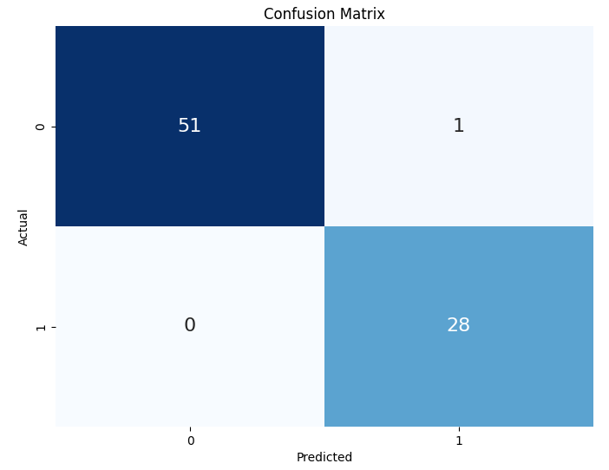
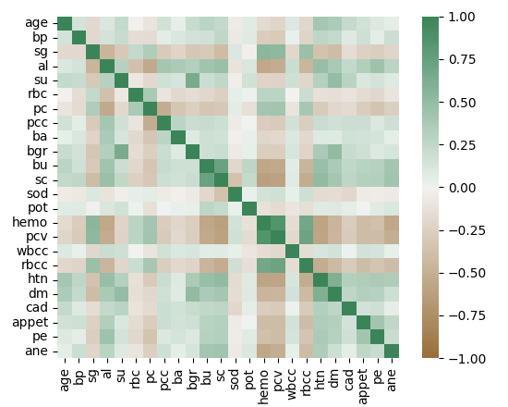
Performance Analysis
Heatmap and Confusion Matrix

Slide 14
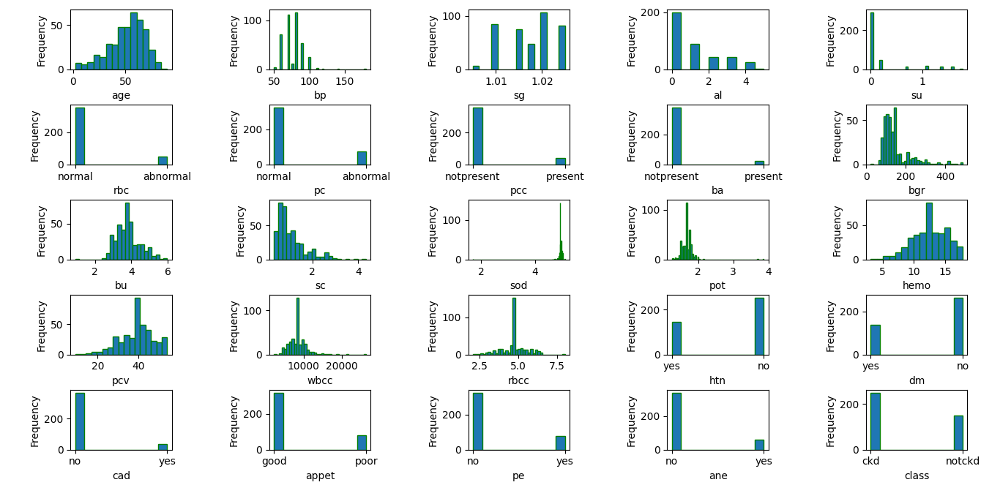
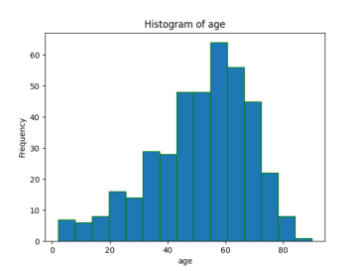
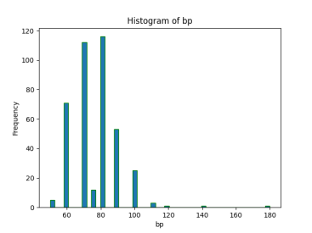
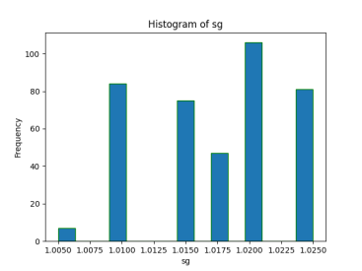
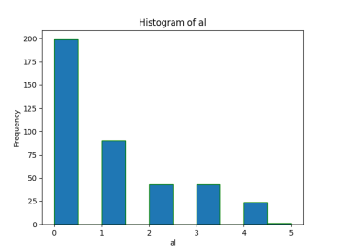
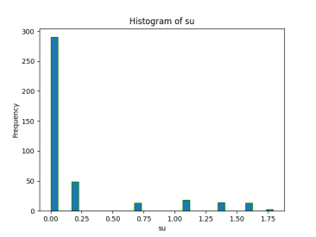
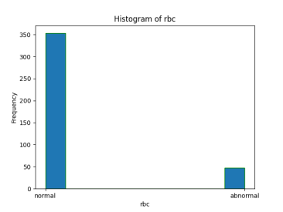
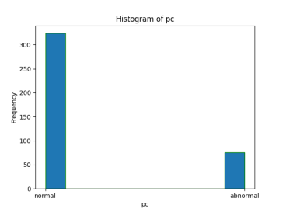

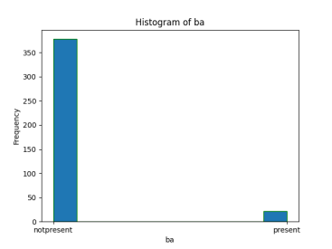
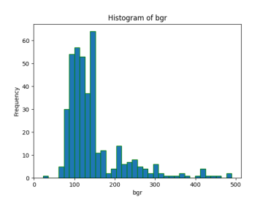
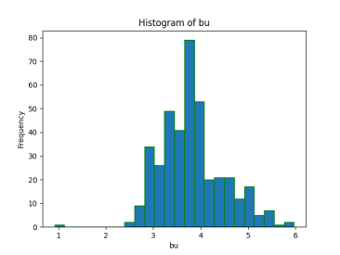
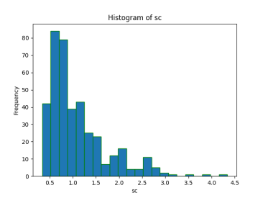
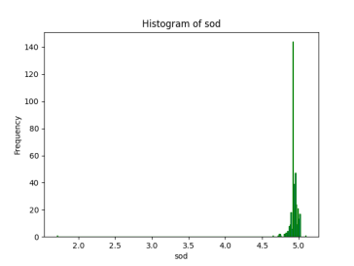
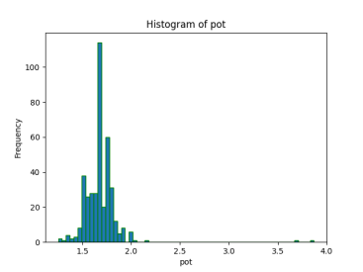
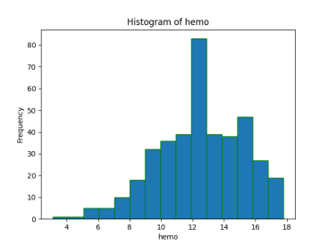
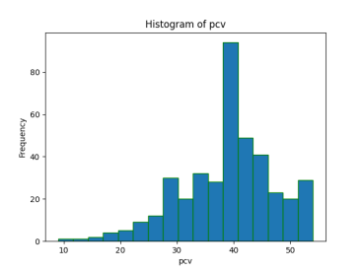
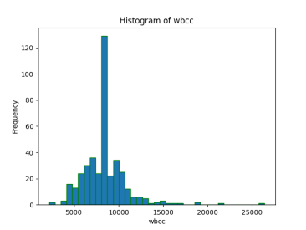
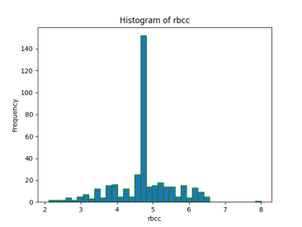
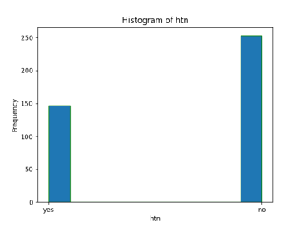
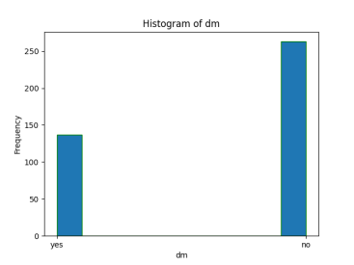
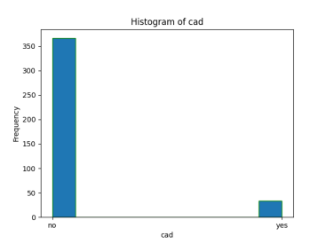
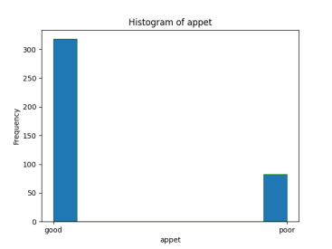

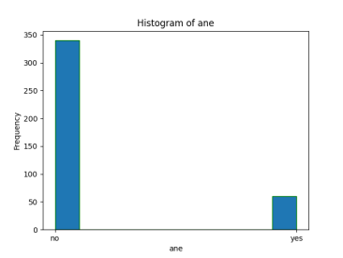
Performance Analysis
Histogram of All Attributes

Slide 15
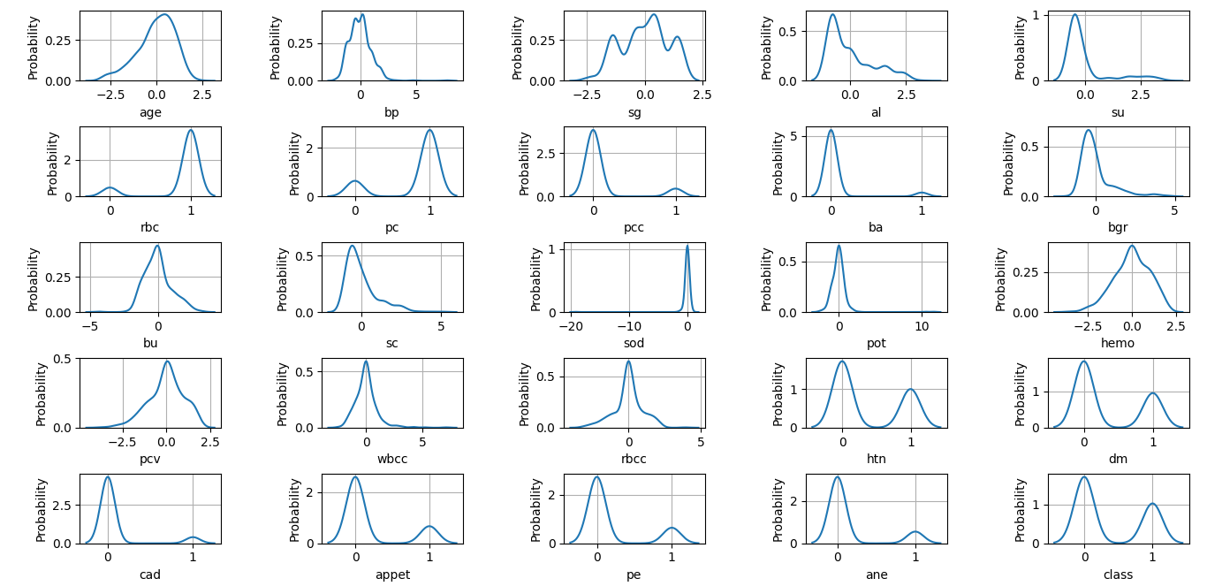
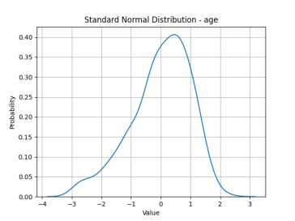
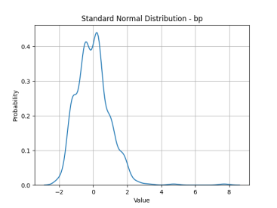
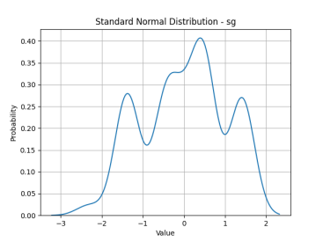
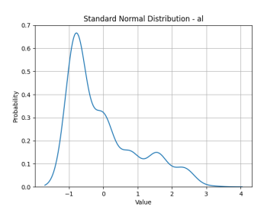
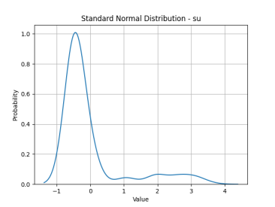
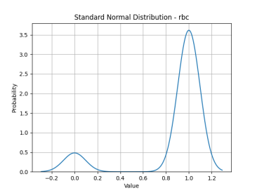
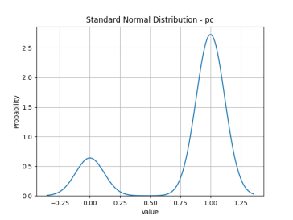
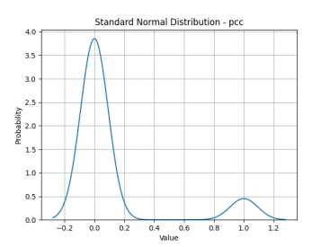
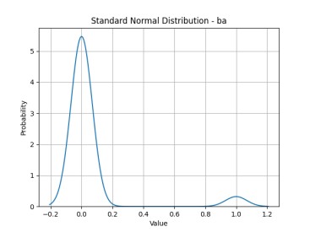
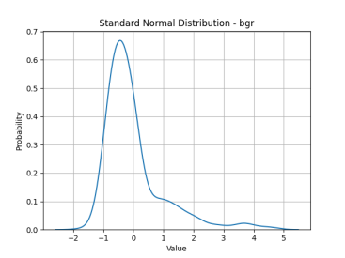
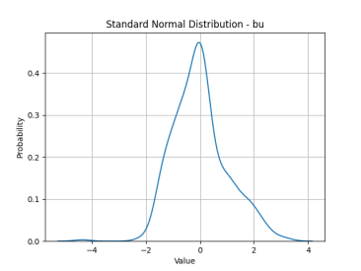
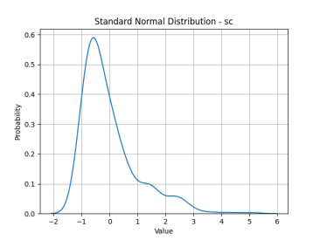
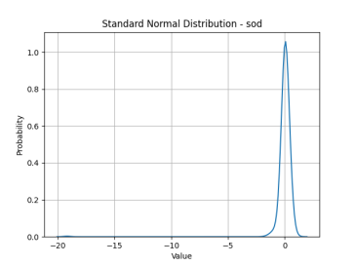
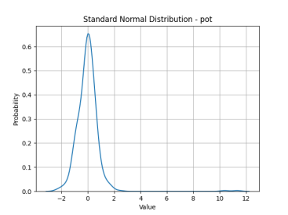
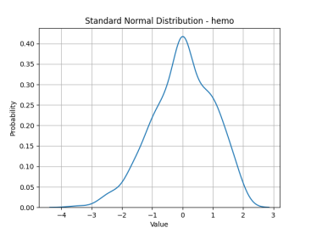
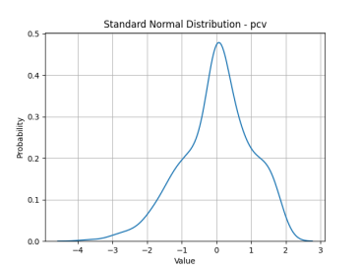
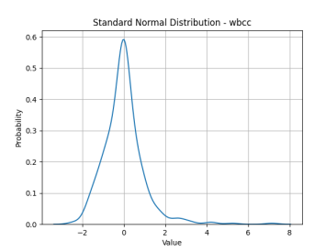
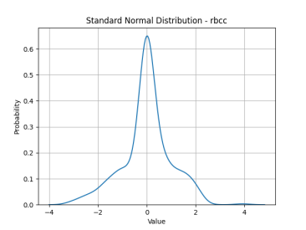
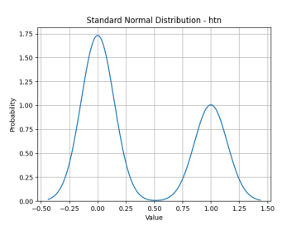
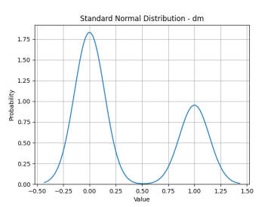
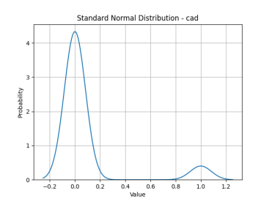



Performance Analysis
Standard Normal Distribution of All Attributes

Slide 16

Data Set

Slide 17
Accuracy Result
ML Algorithms | Accuracy | Model | Accuracy
Random Forest | 100% | Propose Model | 98.75%
Logistic Regression | 98.75%
Decision Tree | 98.75%
Naive Bayes | 98.75%
KNN | 97.50%
SVM | 65%
Best Accuracy Result is Random Forest “100%”
Our Propose Model Accuracy “98.75%”

Slide 18
Accuracy Result
Algorithms/ Model | Accuracy
 | Without Preprocessing | Preprocessing | Feature Extract
Random Forest |  | 100%
Logistic Regression |  | 98.75%
Propose Model |  | 98.75%
Decision Tree |  | 98.75%
Naive Bayes |  | 98.75%
KNN |  | 97.50%
SVM |  | 65%

Slide 19



Comparison
Algorithms/Model | Accuracy (%)
Random Forest | 100
Logistic Regression | 98.75
Propose Model | 98.75
Decision Tree | 98.75
Naive Bayes | 98.75
KNN | 97.50
SVM | 65

Slide 20
References:
[1] Pinar Yildirim, “Chronic Kidney Disease Prediction on Imbalanced Data by Multilayer Perceptron,” 2017 IEEE 41st Annual Computer Software and Applications Conference.
[2] A. Charleonnan, T. Fufaung, T. Niyomwong, W. Chokchueypattanakit, S. Suwannawach, N. Ninchawee, "Predictive Analytics for Chronic Kidney Disease Using Machine Learning Techniques," MITiCON-2016.
[3] Q. Zhang and D. Rothenbacher, "Prevalence of chronic kidney disease in population-based studies: systematic review," BMC Public Health, 2008.
[4] A. R, G. Sasi, R. Sankar, and O. . Deepa, “Decision Support system for diagnosis and prediction of Chronic Renal Failure using Random Subspace Classification,” 2016.
[5] J. Xiao et al, "Comparison and development of machine learning tools in the prediction of chronic kidney disease progression," Journal of Translational Medicine, 2019.
[6] Bhavya Gudeti, Shashvi Mishra, Shaveta Malik, T. F. Fernandez, A. K. Tyagi, Shabnam Kumari, “A Novel Approach to Predict Chronic Kidney Disease using Machine Learning Algorithms,” ICECA-2020.
[7] GunarathneW.H.S.D, Perera K.D.M, Kahandawaarachchi K.A.D.C.P, “Performance Evaluation on Machine Learning Classification Techniques for Disease Classification and Forecasting through Data Analytics for Chronic Kidney Disease (CKD)”, 2017 IEEE 17thInternational Conference on Bioinformatics and Bioengineering.
[8] S.Ramya, Dr.N.Radha, "Diagnosis of Chronic Kidney Disease Using Machine Learning Algorithms," Proc. International Journal of Innovative Research in Computer and Communication Engineering, January 2016.
[9] S. A. Shinde and P. R. Rajeswari, “Intelligent health risk prediction systems using machine learning: a review,” IJET, 2018.
[10] P. Yildirim, “Chronic Kidney Disease Prediction on Imbalanced Data by Multilayer Perceptron: Chronic Kidney Disease Prediction,” in Proceedings - International Computer Software and Applications Conference, 2017.

Slide 21
References:
[11] Rahul Gupta , Nidhi Koli, Niharika Mahor, N Tejashri, “Performance Analysis of Machine Learning Classifier for Predicting Chronic Kidney Disease”, INCET – 2020.
[12] Shinthi Tasnim Himi, Natasha Tanzila Monalisa, Md Whaiduzzaman, Alistair Barros, Mohammad Shorif Uddin, “MedAi: A Smartwatch-Based Application Framework for the Prediction of Common Diseases Using Machine Learning”, IEEEXplore – 2023.
[13] Dibaba Adeba Debal, Tilahun Melak Sitote, “Chronic kidney disease prediction using machine learning techniques”, Journal of Big Data – 2022.
[14] Sourish Ghosh, Anasuya Dasgupta, Aleena Swetapadma, “A Study on Support Vector Machine based Linear and Non-Linear Pattern Classification”, ICISS – 2019.
[15] Kashvi Taunk, Sanjukta De, Srishti Verma, AleenaSwetapadma, “A Brief Review of Nearest Neighbor Algorithm for Learning and Classification”, ICICCS – 2019.
[16] Bahzad Taha Jijo, Adnan Mohsin Abdulazeez, “Classification Based on Decision Tree Algorithm for Machine Learning”, JASTT – 2021.
[17] Sujan Banik, Antara Ghosh, “Prevalence of chronic kidney disease in Bangladesh: a systematic review and meta‑analysis”, International Urology and Nephrology – 2020.

Slide 22
Question ??

Slide 23
Thank You

